Slide 1
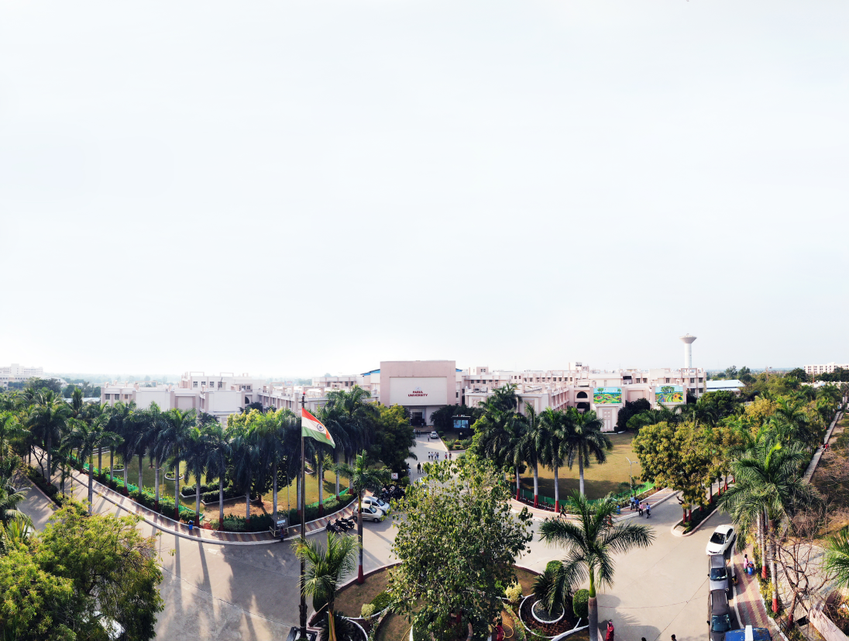


Database Management System
(203105251)
Prof. Rajiv Kumar , Assistant Professor
Computer Science & Engineering

Slide 2
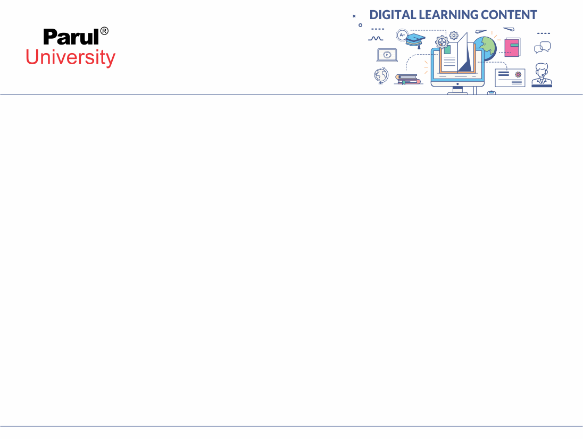

CHAPTER-6
Advance Topics

Slide 3
Object oriented and object relational databases
Idea: add OO features to the type system of SQL. I.e. “plain old SQL”, but...
columns can be of new types (ADTs)
user-defined methods on ADTs
columns can be of complex types
reference types and “deref”
inheritance and collection inheritance
old SQL schemas still work! (backwards compatibility)
Relational vendors all moving this way (SQL:1999).

Slide 4
Object oriented and object relational databases
Postgres group invented a lot of this stuff at Berkeley
And had it working in the early 90’s!
Unfortunately, it defined its own syntax before the standard
And now is not standard-compliant
Most of this stuff can be done in Postgres with analogous syntax
And Postgres has more extra goodies here than SQL:99!

Slide 5
Motivation
Relational model (70’s): clean and simple
great for administrative data
not as good for other kinds of data (e.g. multimedia, networks, CAD)
Object-Oriented models (80’s): complicated, but some influential ideas

Slide 6
Motivation
complex data types
object identity/references
ADTs (encapsulation, behavior goes with data)
Inheritance
Idea: build DBMS based on OO model

Slide 7
Example App: Asset Management
Old world: data models a business
New world: data IS business
1011010111010100010100111 = $$$$$!
software vendors, entertainment industry, direct-mail marketing, etc...
this data is typically more complex than administrative data
Emerging apps mix these two worlds.

Slide 8
Why not a Standard RDBMS?
create table frames (frameno integer, image BLOB,
category integer)
Binary Large Objects (BLOBs) can be stored and fetched
User-level code must provide all logic for BLOBs
Performance
Scenario: client (Machine A) requests “thumbnail” images for all frames in DBMS (Machine B)
Should move code to data, don’t move data to code!
Inefficient, too hard to express queries.

Slide 9
History
In the 1980’s and 90’s, DB researchers recognized benefits of objects. Two research thrusts:
OODBMS: extend C++ with transactionally persistent objects
ORDBMS: extend Relational DBs with object features
Postgres was a Berkeley research project, defined ORDBMSs. Postgres “beat” OODBMSs.
Was commercialized as Illustra
Informix (a relational vendor) bought Illustra and integrated the ORDBMS features into Informix’ core server
Oracle and IBM were forced to compete with Informix
The OODBMS companies never caught on
SQL:1999 standard included many features invented in the Postquel language

Slide 10
History
The Postgres research project went “open source” in 95
Some Berkeley folks converted from Postquel to an extended SQL
The open source community took the code and ran with it
IBM bought Informix a couple years ago
Hence sells 2 of the 3 leading ORDBMS implementations!

Slide 11
An Example SQL:1999 Schema
ADTs
create table frames (frameno integer, image jpeg, category integer);
create table categories (cid integer, name text, lease_price float, comments text);
create type theater_t as row (tno integer, name text, address text, phone integer) ref is system generated;
create table theaters of theater_t ref is tid system generated;
create table nowshowing (film integer, theater ref(theater_t) scope theaters, start date, end date);
create table films (filmno integer, title text, stars varchar(25) array[10], director text, budget float);
create table countries (name text, boundary polygon, population integer, language text)
reference
types
complex
types

Slide 12
Complex Types
use type constructors to generate new types
row (n1 t1, ..., nk tk)
base array [i]
can be nested:
row(filmno integer, stars varchar(25) array [10])
Other obvious extensions:
listof(base)
setof(base)
bagof(base)
Not in the SQL:1999 standard. Postgres supports setof, Informix (commercialized Postgres) supports setof, bagof, listof.

Slide 13
ADTs: User-Defined Atomic Types
Built-in SQL types (int, float, text, etc.) limited
have simple methods as well (math, LIKE, etc.)
ORDBMS: can define new types (& methods)
create type jpeg (internallength = variable,
input = jpeg_in, output = jpeg_out);

Slide 14
ADTs: User-Defined Atomic Types
Not naturally composed of built-in types
new atomic types
Need input & output methods for types
convert from text to internal type and back
we’ll see how to do method definition soon...

Slide 15
Reference Types & Deref.
In ORDBMS, objects can be given object IDs (OIDs)
Unique across time and space
create table theaters of theater_t ref is tid system generated;
Some systems do this for all rows of all tables
So, can “point” to objects -- reference types!
ref(theater_t) scope theaters

Slide 16
Reference Types & Deref.
Don’t confuse reference and complex types!
mytheater row(tno integer, name text, address text, phone integer)
theater ref(theater_t)
Both look same at output, but are different!!
deletion, update, “sharing”
similar to “by value” vs. “by reference” in PL

Slide 17
User-Defined Methods
New ADTs will need methods to manipulate them
e.g. for jpeg: thumbnail, crop, rotate, smooth, etc.
expert user writes these methods in a language like C, compiles them
register methods with ORDBMS:
create function thumbnail(jpeg) returns jpeg
as external name ‘/a/b/c/Dinkey.class’ language ‘Java’
Most ORDBMS bundle a JVM
C functions can be dynamically linked in

Slide 18
OODB Example
Product is abstract
You cannot make a Product directly
You can, however, make a Book, CD, or DVD, and these are Products
Product
Price
Title
Shipping
Book
CD
DVD
Author
Artist
Producer
Publisher
Director
Image Source: cs.nott.ac.uk

Slide 19
An Example Queries in SQL-99
Clog cereal wants to license an image of Herbert in front of a sunrise:
The thumbnail method produces a small image
The is_Sunrise method returns T iff there’s a sunrise in the pic
The is_Herbert method returns T iff Herbert’s in pic
select F.frameno, thumbnail(F.image), C.lease_price
from frames F, categories C
where F.category = C.cid
and is_Sunrise(F.image)
and is_Herbert(F.image);

Slide 20
Another SQL-99 Example
Find theaters showing Herbert films within 100 km of Andorra:
theater attribute of now showing: ref to an object in another table. Use -> as shorthand for deref(theater).name
Array index as in C or Java
select N.theater->name, N.theater->address, F.title
from nowshowing N, frames F, countries C
where N.film = F.filmno
and Overlaps(Radius(N.theater->location, 100), C.boundary)
and C.name = ‘Andorra’
and `Herbert the Worm’ = F.stars[1]

Slide 21
Object Oriented Databases
Advantages
Good integration with Java, C++, etc
Can store complex information
Fast to recover whole objects
Has the advantages of the (familiar) object paradigm
Disadvantages
There is no underlying theory to match the relational model
Can be more complex and less efficient
OODB queries tend to be procedural, unlike SQL

Slide 22
Object Relational Databases
Extend a RDBMS with object concepts
Data values can be objects of arbitrary complexity
These objects have inheritance etc.
You can query the objects as well as the tables
An object relational database
Retains most of the structure of the relational model
Needs extensions to query languages (SQL or relational algebra)

Slide 23
Logical databases
Logical databases are special ABAP programs that retrieve data and make it available to application programs.
Logical databases contain Open SQL statements that read data from the database. You do not therefore need to use SQL in your own programs.

Slide 24
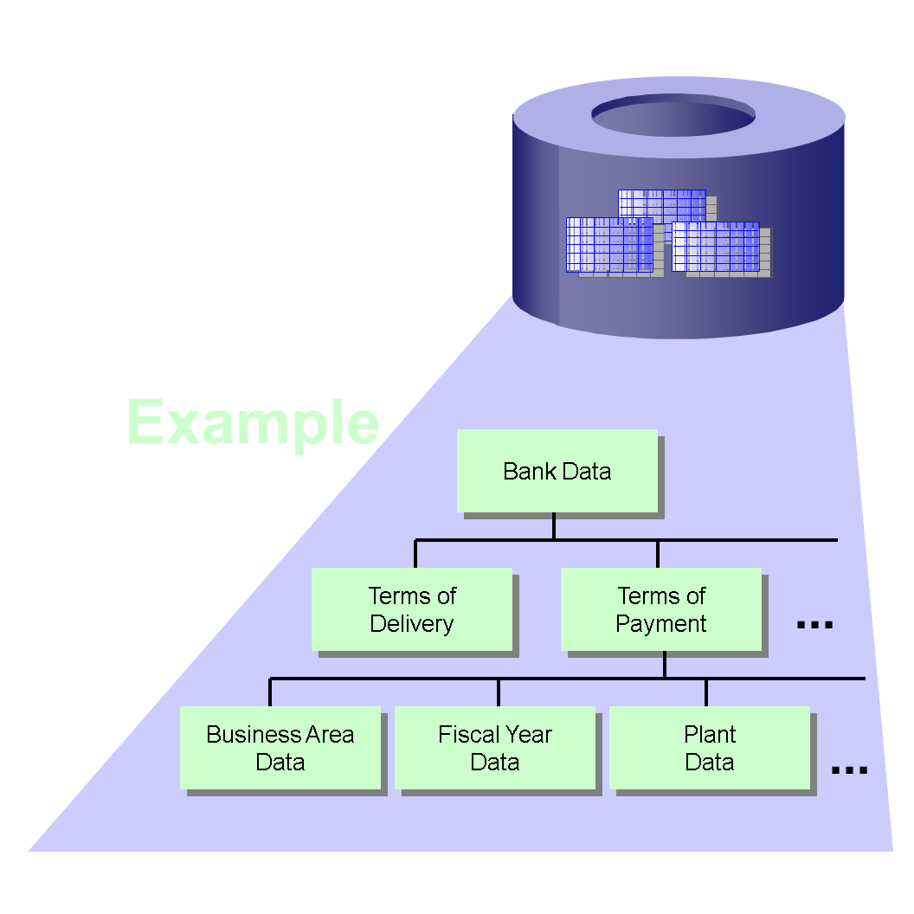
Data Views in Logical Databases
Image Source: sap.com

Slide 25
Tasks of Logical Databases
Logical databases serve mainly to reuse predefined functions for reading data from database tables, but they can also be programmed for other tasks.
To keep the application logic of application programs free from technical details, logical databases can perform the following tasks:
Reading the same data for multiple programs
The individual programs do not then need to know the exact structure of the relevant database tables (and especially not their foreign key relationships).
Instead, they can rely on the logical database to read the database entries in the right order during the GET event.

Slide 26
Tasks of Logical Databases
Defining the same user interface for multiple programs
Each program that uses the same logical databases uses the selection screens of these databases as user interfaces.
Central authorization checks
Authorization checks for centralized sensitive data can be programmed centrally in the database to prevent them from being bypassed by simple application programs.

Slide 27
Tasks of Logical Databases
Improving performance
If you want to improve response times, logical databases permit you to take a number of measures to achieve this (for example, using joins instead of nested SELECT statements).
These become effective immediately in all of the application programs in question and save you from having to modify their source code.

Slide 28
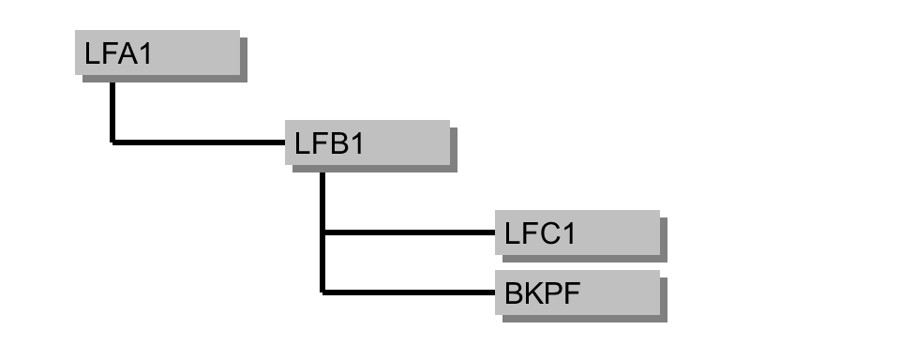
Example of a Logical Database
Let us consider the logical database TEST_LDB.
Ex. Structure
Selections in the Selection Include
SELECT-OPTIONS: slifnr FOR lfa1-lifnr, sbukrs FOR lfb1-bukrs, sgjahr FOR lfc1-gjahr, sbelnr FOR bkpf-belnr.
Image Source: sap.com

Slide 29
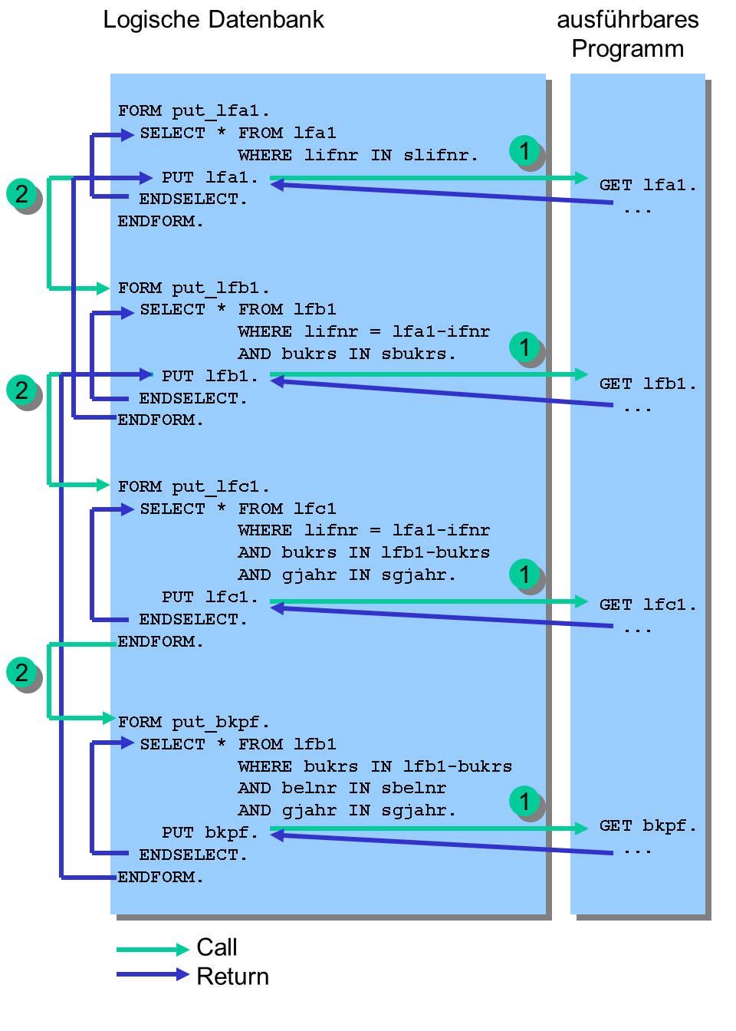
Example of a Logical Database
The order in which the subroutines are called is determined by the structure of the logical database.
Image Source: sap.com

Slide 30
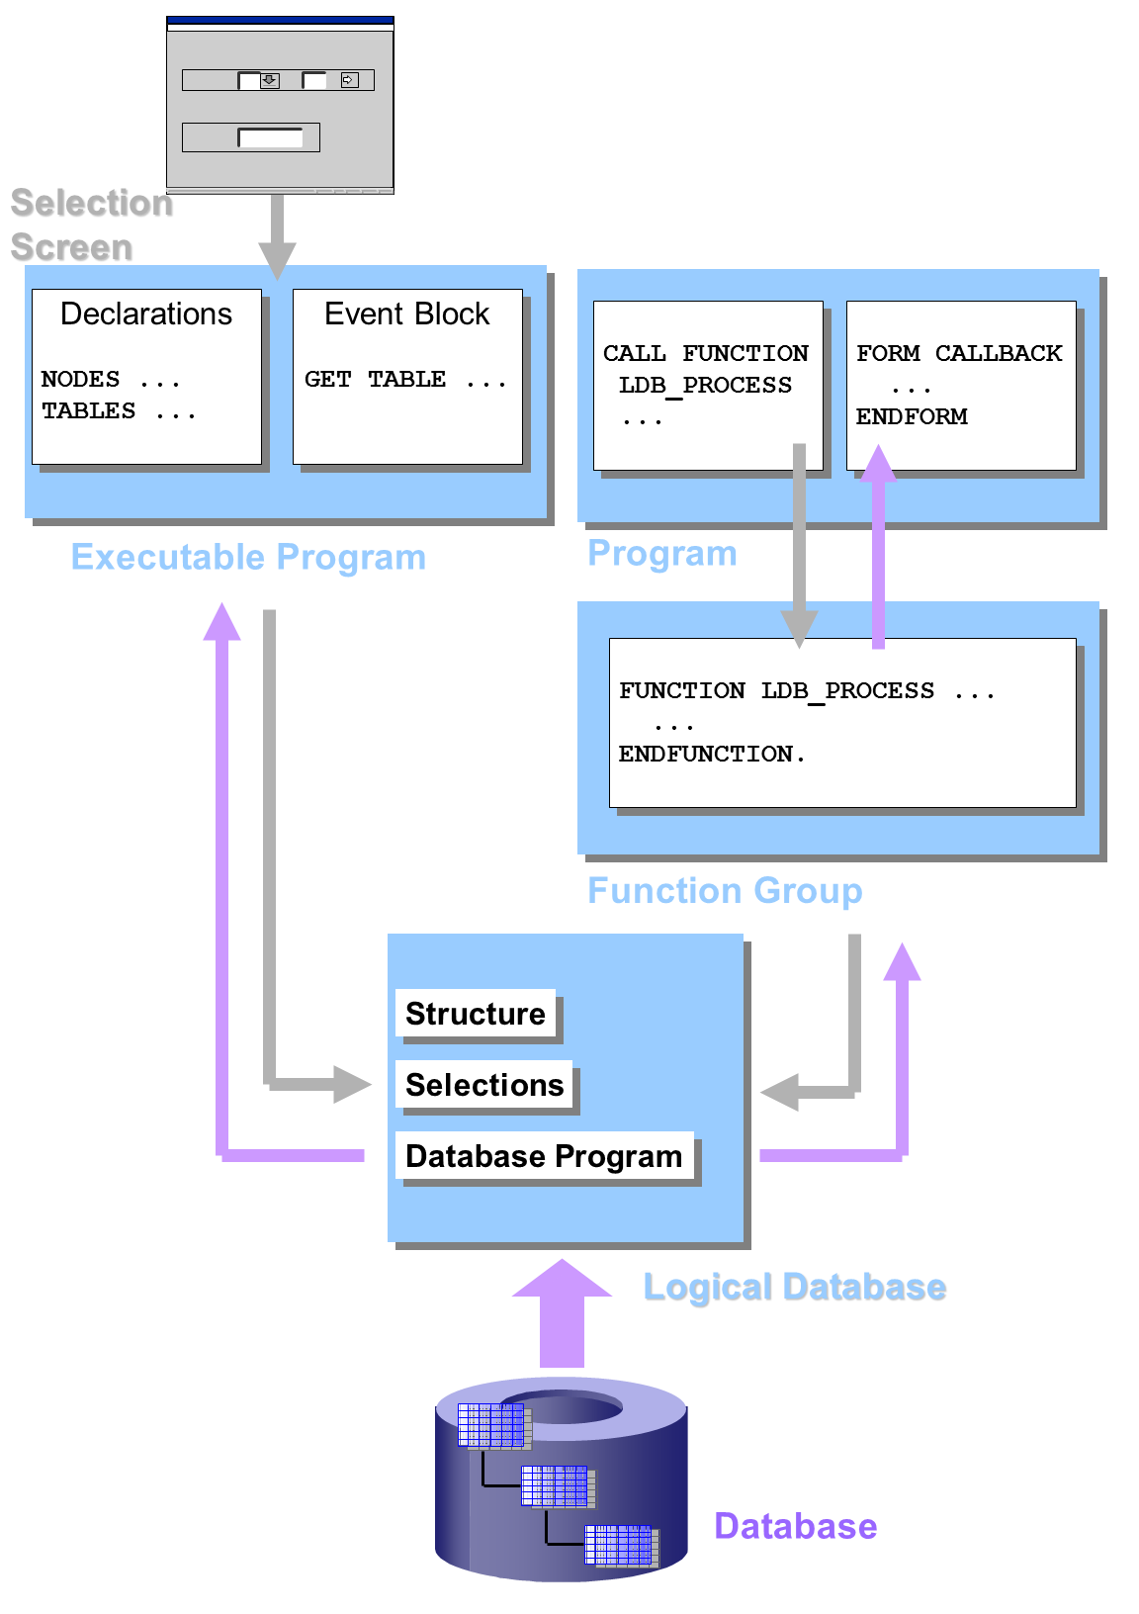
Using Logical Databases
There are two ways of using a logical database: Either by linking it with an executable program, or by using the function module LDB_PROCESS in any ABAP program.
Image Source: sap.com

Slide 31
Using Logical Databases
When you link a logical database to an executable program, the user can enter values on the selection screen, and the data read by the logical database is passed back to the program using the interface work areas.
If you call the logical database using a function module, the selection screen is not displayed.
The calling program does not have to provide interface work areas. Instead, it uses special subroutines called callback routines, which are called by the function module and filled with the required data.

Slide 33
Web databases
Database access over the internet
Web-based clients
Web server
Database server(s)
Web server serves pages to browsers (clients) and can access database(s)
Typical operation
Client sends a request for a page to the web server
Web server sends SQL to database
The web server uses results to create page
The page is returned to the client

Slide 34
Web databases
HTTP request
Client
(Browser)
SQL query
Web
Server
HTML page
Database Server
SQL result
Image Source: cs.nott.ac.uk

Slide 35
Web databases
Advantages
World-wide access
Internet protocols (HTTP, SSL, etc) give uniform access and security
Database structure is hidden from clients
Uses a familiar interface
Disadvantages
Security can be a problem if you are not careful
Interface is less flexible using standard browsers
Limited interactivity over slow connections

Slide 36
Distributed Databases
A distributed DB system consists of several sites
Sites are connected by a network
Each site can hold data and process it
It shouldn’t matter where the data is - the system is a single entity
Distributed database management system (DDBMS)
A DBMS (or set of them) to control the databases
Communication software to handle interaction between sites

Slide 37
Distributed Databases
The client/server architecture is a general model for systems where a service is provided by one system (the server) to another (the client)
Server
Hosts the DBMS and database
Stores the data
Client
User programs that use the database
Use the server for database access

Slide 38
Distributed Databases
Client(s)
Server
Client(s)
Server
Network
Client(s)
Server
Client(s)
Client(s)
Server
Server
Image Source: cs.nott.ac.uk

Slide 39


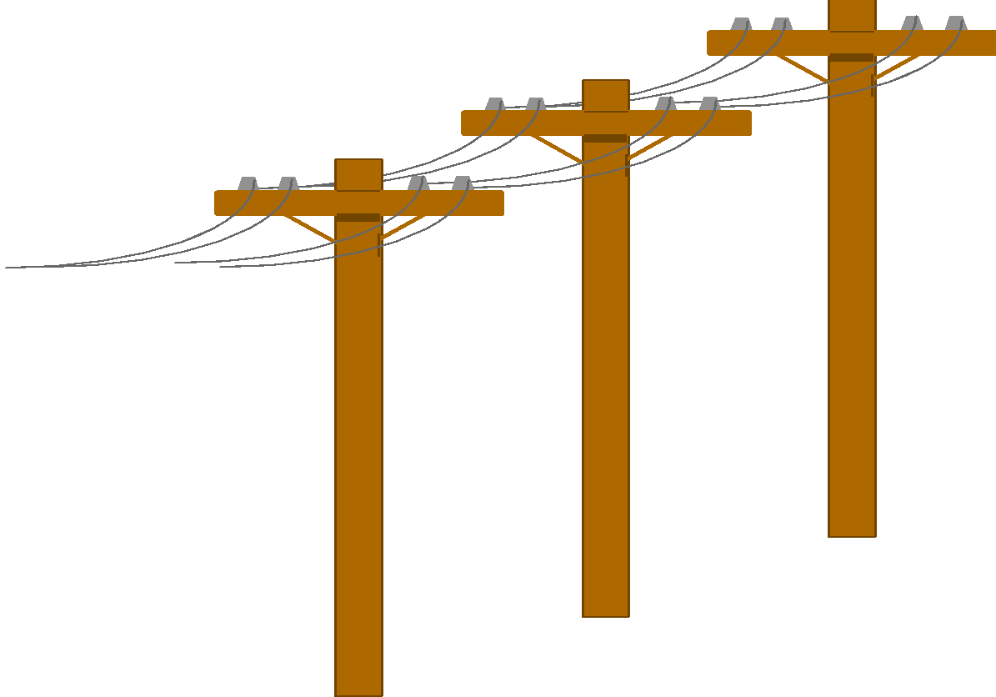

Data warehousing and data mining
Problem: Heterogeneous Information Sources
“Heterogeneities are everywhere”
Personal
Databases
World
Wide
Web
Scientific Databases
Different interfaces
Different data representations
Duplicate and inconsistent information
Digital Libraries
Image Source: cs.tufts.edu

Slide 40
Data warehousing and data mining
Problem: Data Management in Large Enterprises
Sales Planning
Suppliers
Num. Control
Vertical fragmentation of informational systems (vertical stove pipes)
Result of application (user)-driven development of operational systems
Stock Mngmt
Debt Mngmt
Inventory
...
...
...
Sales Administration
Finance
Manufacturing
...
Image Source: cs.tufts.edu

Slide 41

Data warehousing and data mining
Goal: Unified Access to Data
Collects and combines information
Provides integrated view, uniform user interface
Supports sharing
Integration System
World
Wide
Web
Personal
Databases
Digital Libraries
Scientific Databases
Image Source: cs.tufts.edu

Slide 42
The Traditional Research Approach
Query-driven (lazy, on-demand)
Clients
Integration System
Metadata
. . .
Wrapper
Wrapper
Wrapper
. . .
Source
Source
Source
Image Source: cs.tufts.edu

Slide 43
Disadvantages of Query-Driven Approach
Delay in query processing
Slow or unavailable information sources
Complex filtering and integration
Inefficient and potentially expensive for frequent queries
Competes with local processing at sources
Hasn’t caught on in industry

Slide 44
The Warehousing Approach
Information integrated in advance
Stored in wh for direct querying and analysis
Clients
Data
Warehouse
Integration System
Metadata
. . .
Extractor/
Monitor
Extractor/
Monitor
Extractor/
Monitor
. . .
Source
Source
Source
Image Source: cs.tufts.edu

Slide 45
Advantages of Warehousing Approach
High query performance
But not necessarily most current information
Doesn’t interfere with local processing at sources
Complex queries at warehouse
OLTP at information sources
Information copied at warehouse
Can modify, annotate, summarize, restructure, etc.
Can store historical information
Security, no auditing
Has caught on in industry

Slide 46
Data Mining
Major Data Mining Tasks
Classification: predicting an item class
Clustering: finding clusters in data
Associations: e.g. A & B & C occur frequently
Visualization: to facilitate human discovery
Summarization: describing a group
Deviation Detection: finding changes
Estimation: predicting a continuous value
Link Analysis: finding relationships
…

Slide 47
Data Mining
Classification: Linear Regression
Image Source: www.wright.edu

Slide 48
Data Mining
Classification: Decision Trees
Y
if X > 5 then blue
else if Y > 3 then blue
else if X > 2 then green
else blue
3
2
5
X
Image Source: www.wright.edu

Slide 49
Data Mining
Classification: Neural Nets
Can select more complex regions
Can be more accurate
Also can overfit the data – find patterns in random noise
Image Source: www.wright.edu

Slide 50
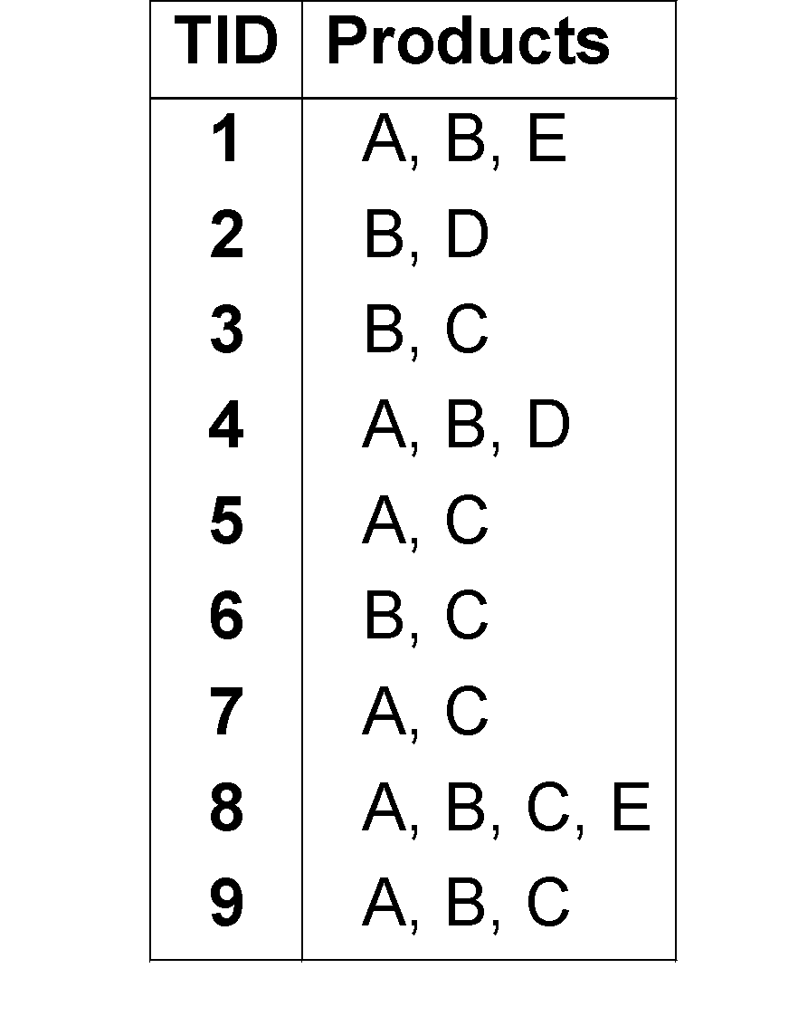
Data mining technique: Association
Transaction database: Example
Instances = Transactions
ITEMS:
A = milk
B= bread
C= cereal
D= sugar
E= eggs

Slide 51
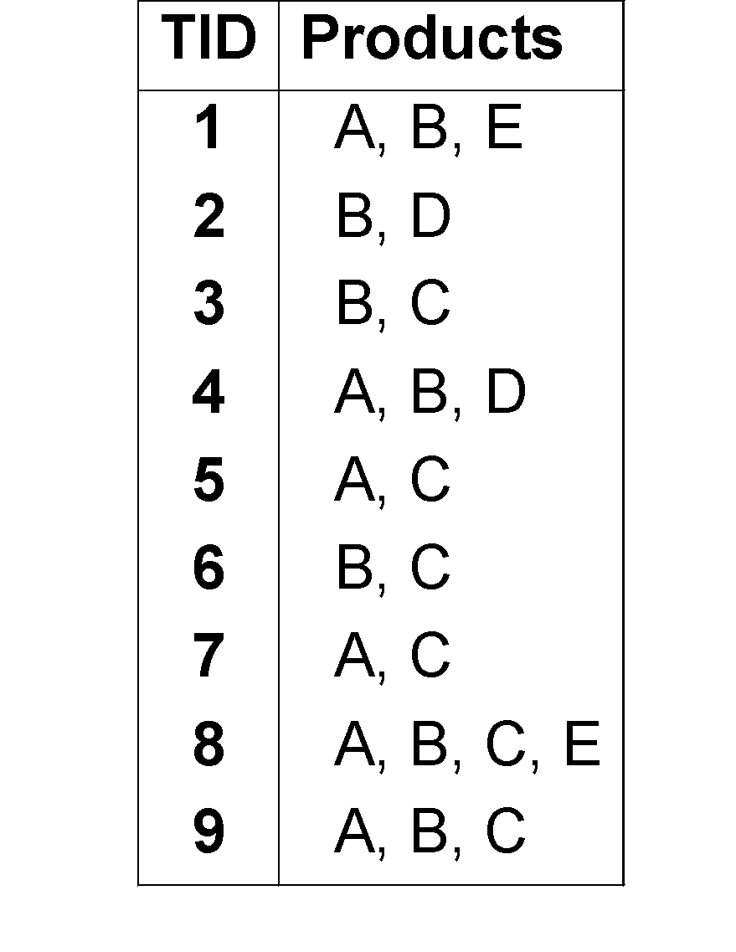
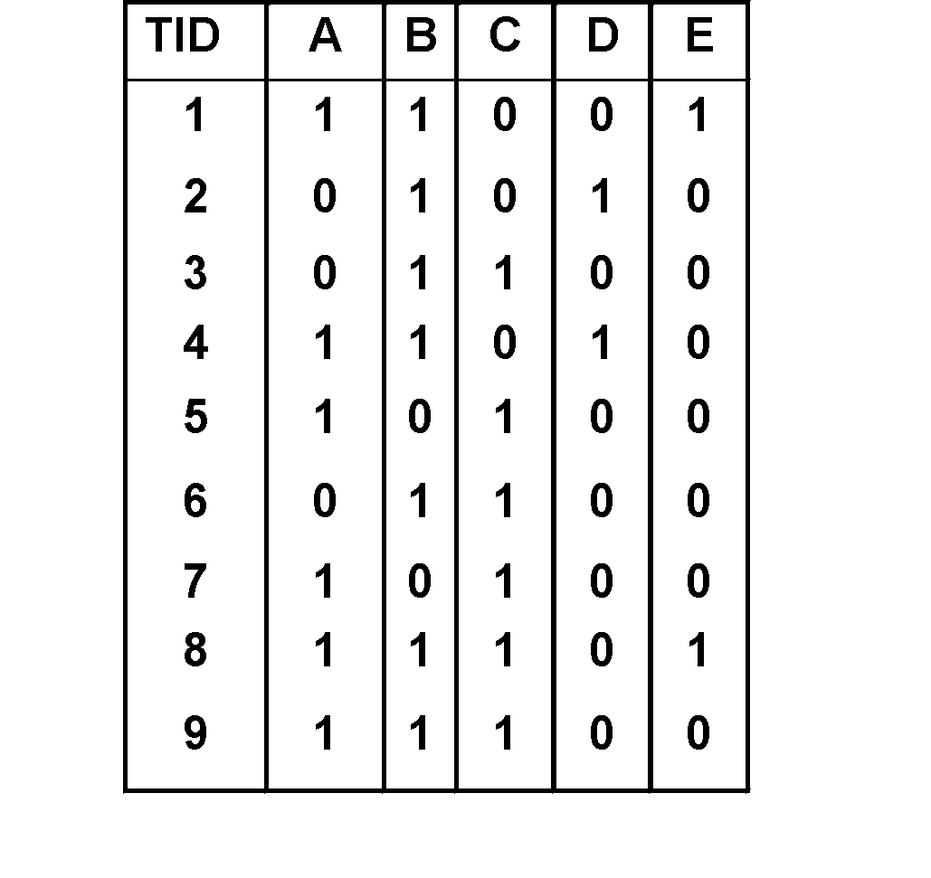
Data mining technique: Association
Transaction database: Example
Attributes converted to binary flags

Slide 52
Data mining technique: Association
Definitions
Item: attribute=value pair or simply value
usually attributes are converted to binary flags for each value, e.g. product=“A” is written as “A”
Itemset I : a subset of possible items
Example: I = {A,B,E} (order unimportant)
Transaction: (TID, itemset)
TID is transaction ID

Slide 53


www.paruluniversity.ac.in

